Slide 1
Thunder Camp
Ronald Thornton Middle School
July 28, 2023

Slide 2
Welcome Parents!
Introductions:
Dr. Kargbo – Principal
Dr. Williams – Associate Principal
Ms. Skinner – 6th Grade Assistant Principal
Ms. Jefferson – 6th Grade Counselor
Topics:
Thunder PRIDE
A day at RTMS
Behavior Expectations
Resources for Support

Slide 3
Thunder PRIDE

Slide 4
A Day at RTMS!
Arrival 8:20-8:45 am
Tardy Bell at 8:55 am
7 period day – 5-minute passing
6th separate from 7th & 8th
Classes 45-60 minutes each
1st, 4th & 7th Periods longer for announcements, lunch & dismissal
4 lunch periods – 30-minutes each
Dismissal at 4:10 pm
Options: Car, Walk, Bike, or Bus
Must leave campus after school unless scheduled tutorial, club, or detention

Slide 5
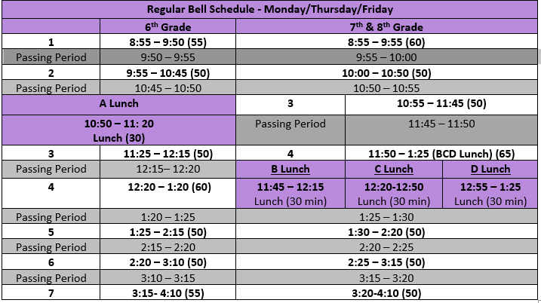
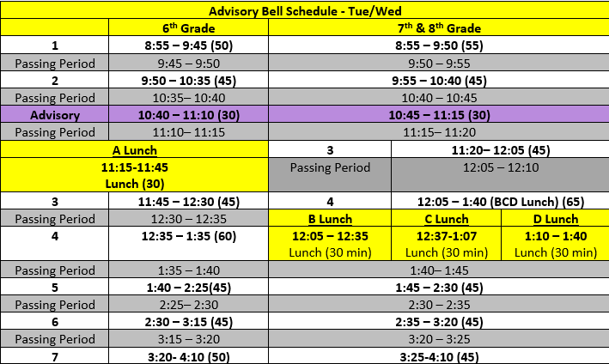
Bell Schedules

Slide 6
What to Bring to School…
YES – Bring…
Backpack
Lunch, Water Bottle & Snack (2:00 snack time)
PE/Kickstart clothes & shoes
School supplies
Personal computer (optional)
Lock for your bike
NO – Do not bring…
Video game devices
Toys
Ear buds
Expensive personal items
Unnecessary cash
Prohibited items – vape/smoke items, weapons, inappropriate materials, et.

Slide 7
Middle School Awareness
Freedom = Responsibility
6th Grade will earn more freedoms
Start with sitting by class for lunch
Escorted to 1st period
Horseplay often escalates
Red flag words to discuss with your child
Legislative ruling on vaping
Monitoring personal communication devices

Slide 8
Communication & Resources
Thundercat Weekly – First one sent yesterday
School Website – Will be updated by 8/8/23
Teacher Schoology Page – Accessible 8/9/23
Teacher Weekly Emails
Have questions or concerns throughout the year:
Contact the teacher
Contact Grade-Level Administrators
Ms. Jefferson, 6th Grade Counselor
Ms. Skinner, 6th Grade Assistant Principal
Contact Principals
Dr. Williams, Associate Principal
Dr. Kargbo, RTMS Principal

Slide 9
Thunder Camp
Stations:
PE Uniforms
Kickstart Uniforms
Yearbook
PTO ~ Spirit Wear
Parents ~ Please remain in the gym until your student arrives or return at 11:00 am or 4:00 pm, when Thunder Camp concludes .
Thanks for coming! Don’t forget to snap a picture!

Slide 10
Thunder Camp
Ronald Thornton Middle School
July 28, 2023

